Slide 1
Calculate Table
Calculate Table

Slide 2
Calculate Table
Note: This demo uses the AdventureWorks2016 database and more specifically the DimProduct and FactInternetSales table
Start by creating a measure that calculates the average amount of turnover achieved corresponding to the product class M
AVG Sales Class M =
CALCULATE(
AVERAGE(FactInternetSales[OrderQuantity]) *AVERAGE(FactInternetSales[UnitPrice]),
DimProduct[Class] = "M"
)

Slide 3
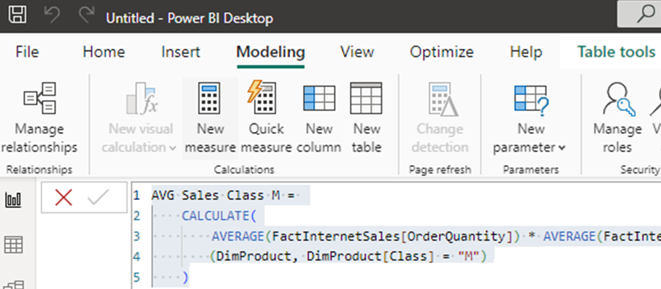
Calculate Table
In the Modeling tab, click New Table

Slide 4
Calculate Table
Create a view of the DimProduct table that leaves only products with a tax value greater than 1
DimProduct(TaxAmt Greater than 1)=CALCULATETABLE(DimProduct,FILTER(FactInternetSales, FactInternetSales[TaxAmt]>1))
Conclude that the Calculate function is used to calculate calculated measures and columns however CalculateTable is used to create filtered views

Slide 5
Thank you
Thank you

